Slide 1
Tidyverse Workshop

Slide 2
Agenda
What is Tidyverse?
Data
Visualizations

Slide 3
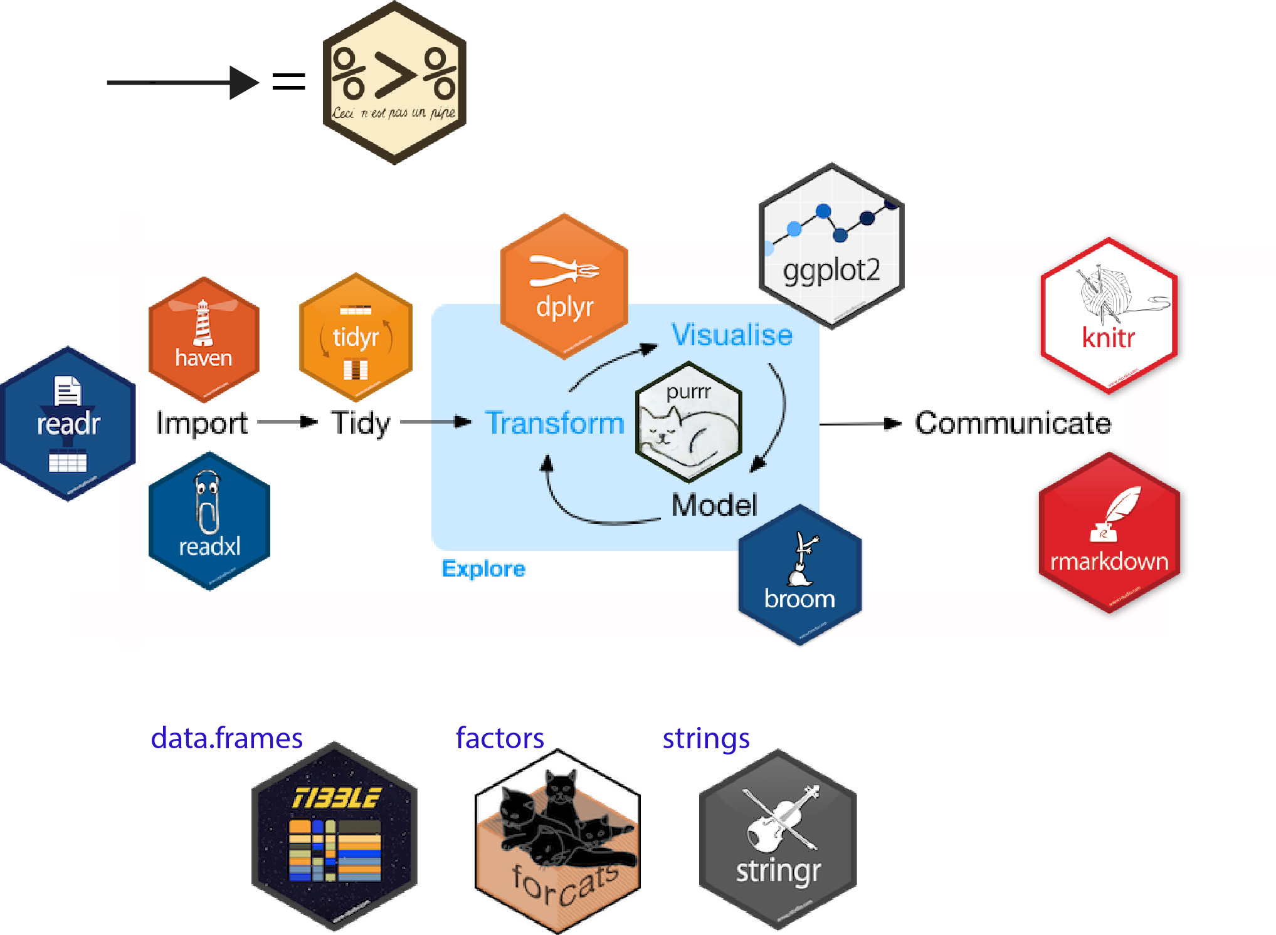
What is Tidverse?
Tidyverse is a collection of R packages used in conjunction for data science.

Slide 4
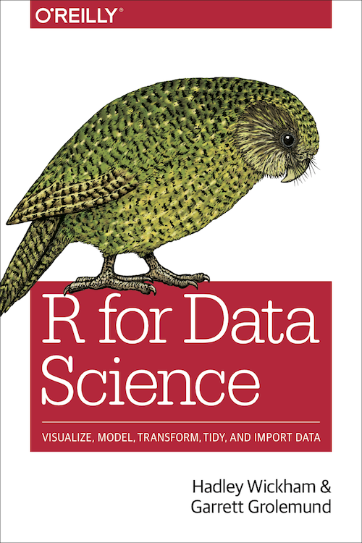
Where Can You Learn More?
Written in part by Hadley Wickham, Chief Scientist at R
Instructional book on how to use Tidyverse package
You can find this book here: http://r4ds.had.co.nz/

Slide 5
What Should You Takeaway?
Data Manipulation
%>%
Filter
Group_by
Summarize
Rename
Select
Mutate
Data Visualization
GGPlot
Plotly

Slide 6
About the Data Set
Franklin County Car Crash Data
Found Here: https://ckan.smartcolumbusos.com/dataset/crash-data-for-franklin-county-2014-2016

